Slide 1
Video editing using ai
By(BCSE498J)
Name :G. Divakar Reddy(21BCE3417) ,
M. Guru Shrekar(21BCE3738)
Under the Guidance of
Dr. Karthik. K

Slide 2
OBJECTIVE
The objective of using AI in video editing is to make the process easier, faster, and more creative. AI can help automate simple tasks like cutting scenes, adding transitions, or adjusting brightness, which saves time for the editor. It can also improve video quality by fixing colors, removing noise, and making the video clearer. AI can understand the content of a video, like recognizing people or objects, and suggest edits that make the video more interesting or meaningful. It can also help with audio by cleaning up sound, adjusting volumes, and syncing audio with video. Another goal is for AI to work in real-time, which is useful for live streams or quick video creation. The aim is to make AI tools easier for human editors to use, so they can collaborate with AI and make creative decisions together. AI enhances video editing by automating tasks like noise reduction, silence removal, auto trimming, and selective blur. It detects and removes unwanted sounds while preserving important audio, trims out silent parts, and cuts unnecessary footage by recognizing key moments. For selective blur, AI applies it to specific areas like faces while keeping the main subject clear.

Slide 3
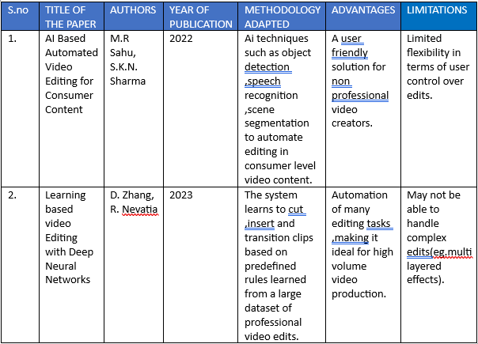
LITERATURE SURVEY

Slide 4
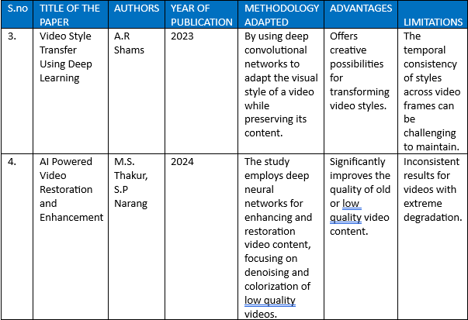

Slide 5
RESEARCH GAPS
AI in video editing is progressing, but there are still some challenges that need to be addressed. One big issue is that AI struggles to understand the context or meaning behind the events in a video. For instance, while it can recognize that people are talking, it might not grasp the emotional tone or the reason behind the conversation, which can make edits feel less natural. Another problem is the quality of automated edits. Although AI can handle tasks like cutting scenes or adding transitions, it doesn’t yet match the creativity and professionalism of human editors. Additionally, AI needs to improve at adapting its editing style to suit different types of videos whether they are fast-paced or slow and cinematic. When it comes to creativity, AI is not yet good at making artistic choices, like picking the right music or conveying the right mood. Audio editing is another area where AI struggles, especially when it comes to cleaning up sound or synchronizing audio with video. Real-time video editing, such as during live streams, also presents challenges because AI needs to make decisions quickly. Finally, while AI tools assist editors, they don't truly collaborate with them in a creative way. Improving AI's ability to interact with human editors could lead to a more seamless and creative editing process.

Slide 6
SOFTWARE SPECIFICATIONS
The libraries you mentioned MoviePy, Pygame, Librosa, Pillow (PIL), and OpenCV (cv2)—are essential tools for audio and video manipulation in Python. MoviePy is a versatile video editing library that allows you to cut, concatenate, resize, add effects, and manipulate both video and audio. It can also create animations, add text, and handle multiple formats. Pygame, primarily used for game development, also supports video playback, sound mixing, and media manipulation for interactive applications. Librosa is a specialized library for audio analysis and manipulation, perfect for tasks like pitch shifting, tempo changes, and spectral analysis. Pillow (formerly PIL) focuses on image processing and can be used to manipulate video frames, apply filters, resize, crop, and convert image formats. Lastly, OpenCV is a powerful computer vision library, ideal for video analysis, real-time frame manipulation, object detection, motion tracking, and video capture, making it widely used in video processing. Together, these libraries provide a comprehensive toolkit for multimedia manipulation in Python.

Slide 7
HARDWARE SPECIFICATIONS
For a video editing project using AI, having the right hardware is crucial to handle the demanding tasks involved. A fast processor (CPU), such as an Intel i5 or AMD Ryzen 7, is essential for managing both video editing and AI computations efficiently. A graphics card (GPU) like the Intel Iris Xe is necessary to speed up rendering and boost AI performance, especially for tasks like real-time video processing. RAM (Memory) is also important, as video editing with high-resolution files can be very memory-intensive. A minimum of 8GB of RAM is recommended, with 32GB being ideal for smooth performance. For storage, a solid-state drive (SSD) with at least 512GB is recommended to store video files and software, and adding an extra 1TB of storage will help with larger video files and AI models. A high-resolution display (1080p ) is vital for clear video details during editing, and a larger screen or dual-monitor setup can help improve workflow efficiency. Lastly, since video editing and AI tasks can generate a lot of heat, a cooling system is necessary to prevent the system from overheating during extended use.

Slide 8
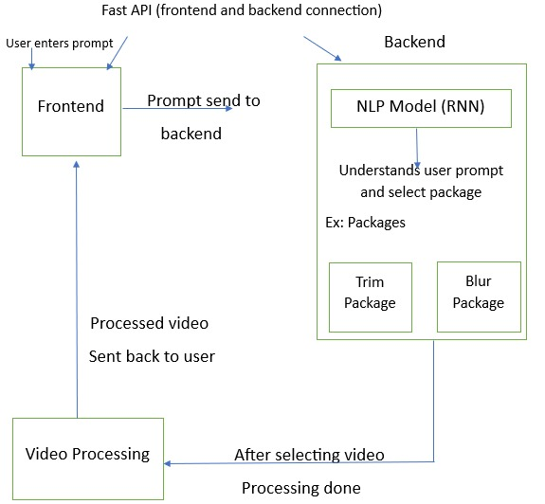
Flow Diagram

Slide 9
MODULE DESIGN
The system will be structured with both a frontend and a backend to provide a smooth and efficient video editing experience.
For the frontend (user interface), the application will use React.js for web-based apps. The frontend will focus on creating an easy-to-navigate editing dashboard, where users can preview their videos and access various editing options, such as trimming, adding effects, and adjusting colors.
The backend (processing and storage) will rely on Python for the AI models that perform video analysis and editing tasks. TensorFlow will be used for machine learning, helping the AI recognize scenes, suggest edits, and improve video quality. For server-side operations, Node.js will be used to manage requests, run the backend logic, and integrate with cloud storage to save video files and data.
An NLP model using RNNs can understand text prompts like "trim the video" and trigger automated video editing tasks. It uses Python libraries like MoviePy for video editing and Pydub for audio manipulation. The system processes the commands and produces the edited video with the requested effects and adjustments.

Slide 10


Slide 11
CONCLUSION
In conclusion, our project makes sure that the job of content creators is kept to creation and not processing and post-production. Editing leads for the user to be more productive and creative in their respective field. This is also accompanied by reducing the costs and amount spent on editing. The study also acknowledges that we found limitations in the project, for what extents our model is applicable to modern editing scenes. Complexity is identified, but it still is a tedious task to apply deep learning on video editing, and time taken to process is not consistent with all systems.

Slide 12

Thank you

